Slide 1






Looping of Project Air introduction slide

Slide 2




Project Air overview (semi-static)
Electrolysis
Hydrogen
CO₂
CO₂
Manure
H₂
CO₂
H₂
Sustainable methanol
Bio-waste
CO
CO₂
Methanol production
Household waste
Synthesis gas
Biogas
Residue streams
Gasification
Perstorp Oxo
Perstorp site in Stenungsund
Notes:
Bring this slide into the introduction slide that will go into a continuous loop until user interaction

Slide 3
Who is Perstorp Oxo?
CO₂
Bla bla bla
CO₂
CO₂
What does Perstorp Oxo do?
Project Air Bla bla bla
CCU Bla bla bla
Perstorp Oxo
Notes:
2 text boxes and one grafic box that allows processes to be shown visually and with animation
Perstorp Oxo text and factory appear together and grow in size
CO2 bubbles rise from the chimney one at a time
Text appears in a dashed frame

Slide 4
What is biogas?
Bla bla bla
Manure
What is it used for?
Bla bla bla
Bla bla bla
Biogas
Notes:
2 text boxes and one grafic box that allows processes to be shown visually and with animation
Perstorp Oxo text and factory appear together and grow in size
CO2 bubbles rise from the chimney one at a time
Text appears in a dashed frame

Slide 5
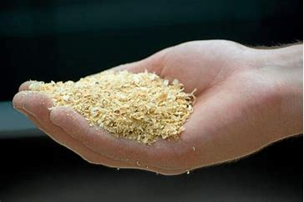
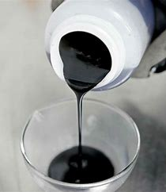
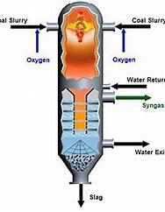
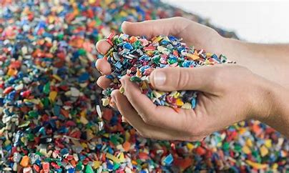
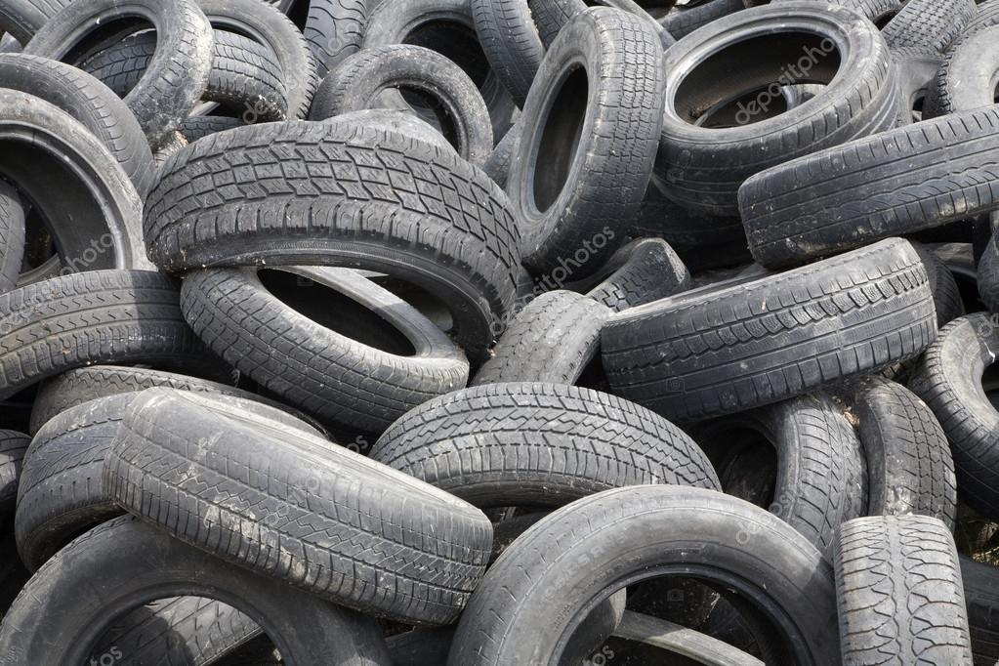
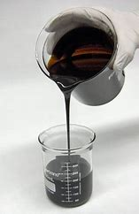
What is gasification?
Bla bla bla
CO₂
H₂
CO
How does it work?
Pyrolys-förbehandling
Pyrolysolja
Förgasning
Bla bla bla
Bla bla bla
Gasification
Återvunnen olja (Stena)
Notes:
2 text boxes and one grafic box that allows processes to be shown visually and with animation
Perstorp Oxo text and factory appear together and grow in size
CO2 bubbles rise from the chimney one at a time
Text appears in a dashed frame

Slide 6
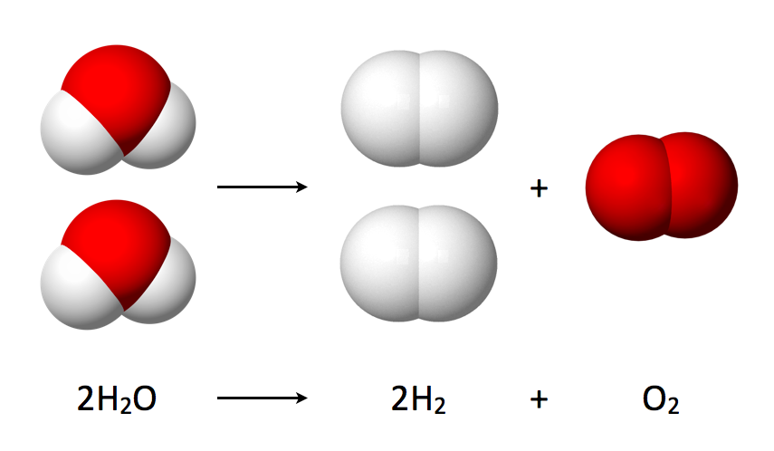
What is Hydrogen Electrolysis?
Bla bla bla
How does hydrogen electrolysis work?
Bla bla bla
Bla bla bla
Electrolysis
Hydrogen
Notes:
2 text boxes and one grafic box that allows processes to be shown visually and with animation
Perstorp Oxo text and factory appear together and grow in size
CO2 bubbles rise from the chimney one at a time
Text appears in a dashed frame

Slide 7
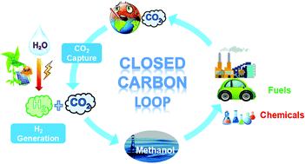
What is sustainable methanol used for?
Sustainable methanol
Bla bla bla
How does this close the Carbon Loop?
Bla bla bla
Bla bla bla
Notes:
2 text boxes and one grafic box that allows processes to be shown visually and with animation
Perstorp Oxo text and factory appear together and grow in size
CO2 bubbles rise from the chimney one at a time
Text appears in a dashed frame

Slide 8
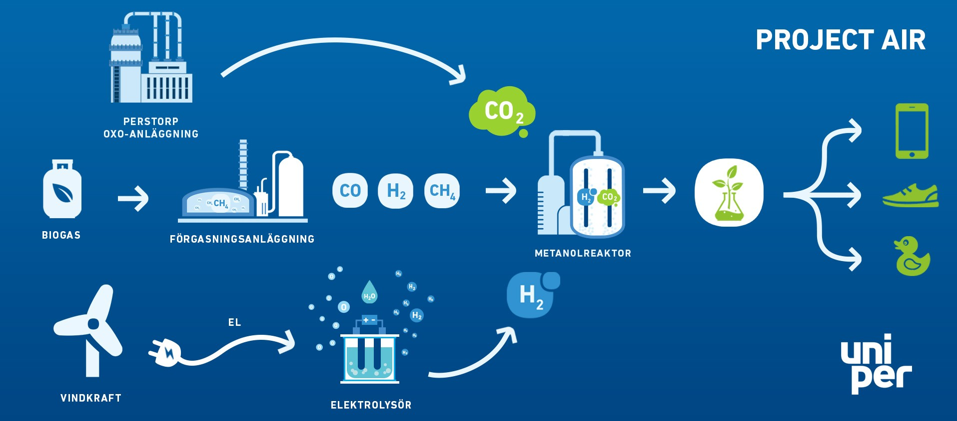
(F) Gasification

